Slide 1
Data sources
Plan to use data sources with timestamps and balances
Extract more features from existing data sets for training
Notes:
Data sources
Plan to use data sources with timestamps and balances
Extract more features from existing data sets for training
计划使用带有时间戳和余额的数据源;
在现有的数据集中提取出更多特征供训练

Slide 2
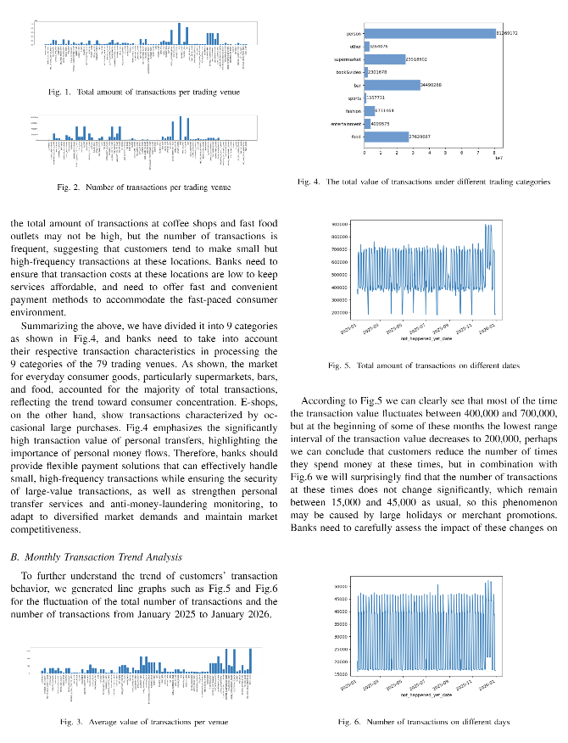
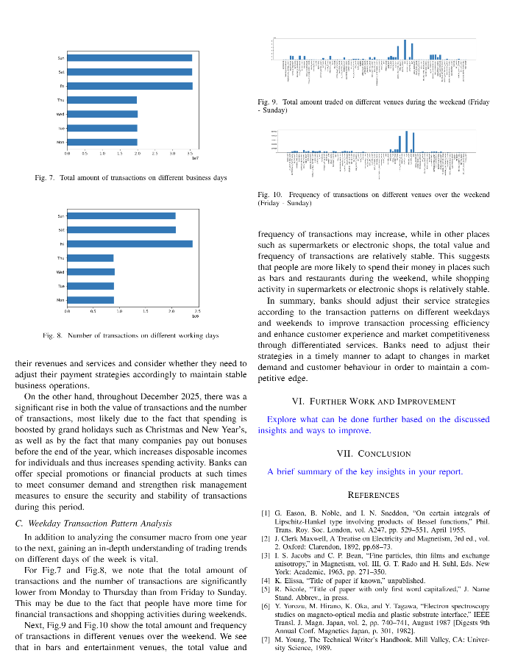
Project Progress
Deploy jupyter service on AWS
Define the Problem or Objective
Data Cleaning
Data preprocessing
Exploratory Data Analysis (EDA)
Modeling
Model Evaluation
Feedback and Iteration
Report Progress
Abstract
Introduction
Data Description/ Preparation
Results and Discussions
Further Work and Improvement
Conclusion
Literature Review
Methodology
References
Notes:
Progress so far (including plots)
定义问题和目标
数据清理
数据预处理
探索性数据分析
建模
模型评估
反馈与迭代
Abstract
Introduction
A brief discussion of the problem context, motivation, analysis questions/aims and proposed methods and approaches used.
Literature Review
An overview of related work of similar research in the domain.
Methodology
Includes a discussion of methods applied to address your questions/aims
Data Description/ Preparation
Includes description of data sources, samples and steps for pre-processing if any.
Results and Discussions
Reporting on the experiments with discussion on insights. Technical challenges are to be discussed here too.
Further Work and Improvement
Explore what can be done further based on the discussed insights and ways to improve.
Conclusion
A brief summary of the key insights in your report
References

Slide 3
Next planned steps
Account balance analysis
Trading behavior analysis
Optimize bank operations
Predict
Transaction
amount
Notes:
Next planned steps
Analyze the transaction behavior of each user and the income of each trading venue; predict user transaction amounts by using multiple models; analyze changes in user balances; analyze how the above conclusions can better help bank operations in conjunction with actual practice
对各用户交易行为、各交易场所收入情况进行分析;通过使用多种模型预测用户交易金额;用户余额变化分析;联系实际分析上述结论如何更好的帮助银行运营

Slide 4
Challenges
Fraud detection and customer churn prediction
Using onehot encoding
No corresponding columns
Customer classification
Too many columns
Be suspected of discrimination
Notes:
Challenges
Using onehot encoding will result in too many columns; I want to do fraud detection and customer churn prediction, but there are no corresponding columns; Customer classification (low, middle and high income groups), will it be suspected of discrimination?

